Slide 1
nghbrly
Mobile App Focused on Fostering Neighbor to Neighbor Interactions
Andrew Brook

Slide 2
pronounced: neighborly
nghbrly is a mobile app thats focus is to provide an easy way for neighbors to both ask for help as well as provide help
nghbrly

Slide 3
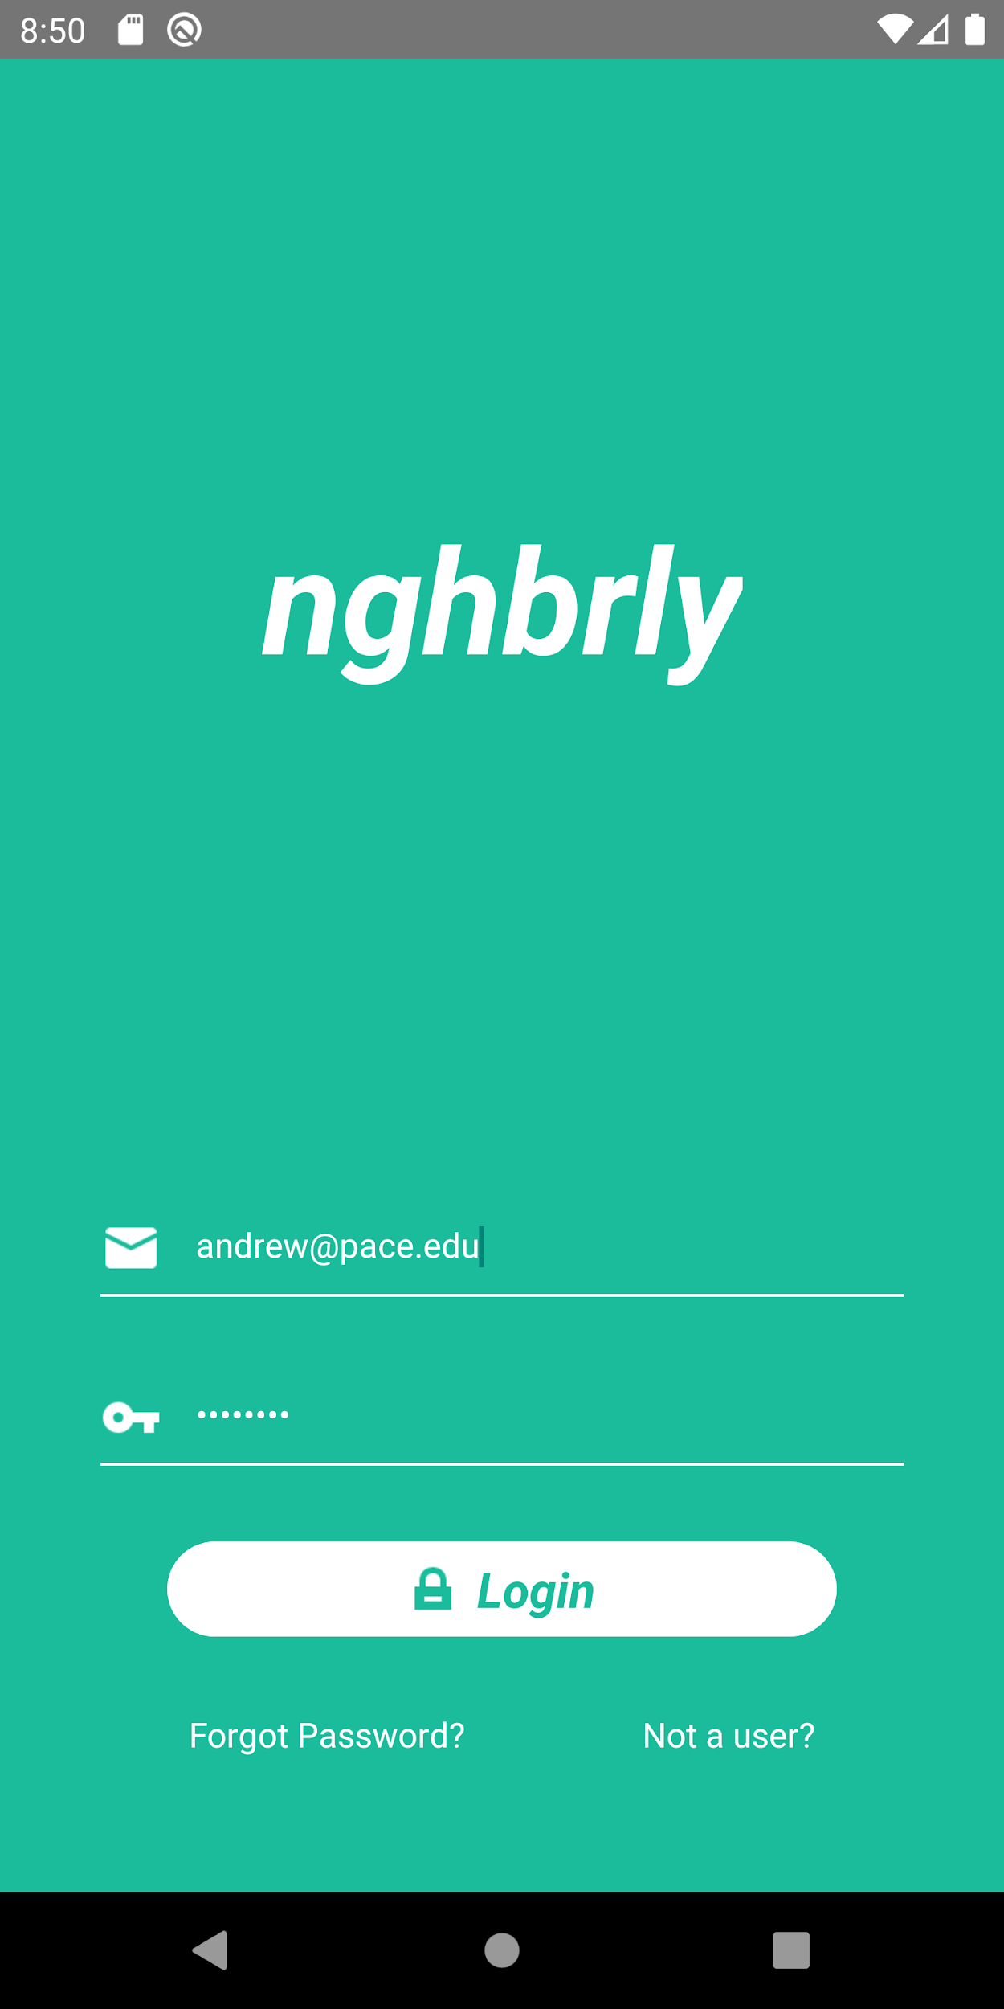
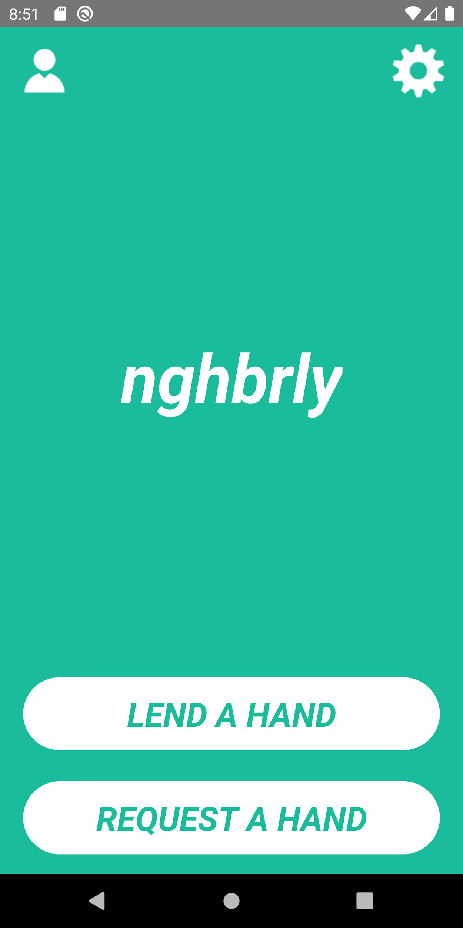
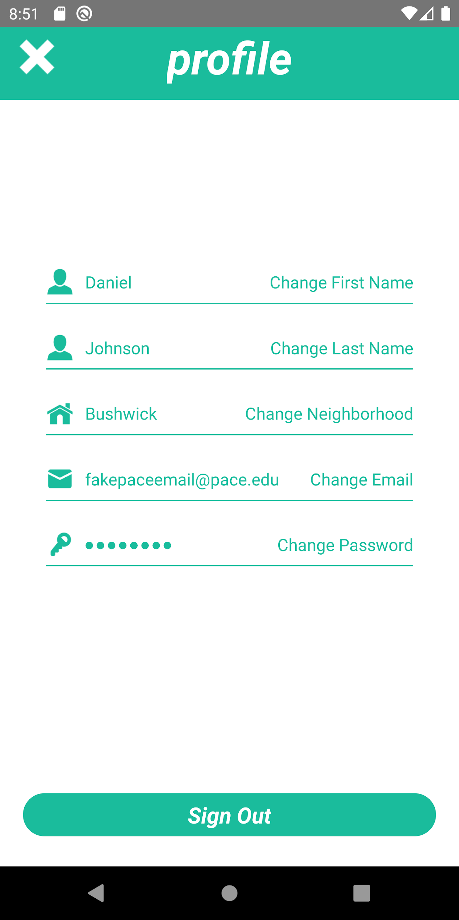
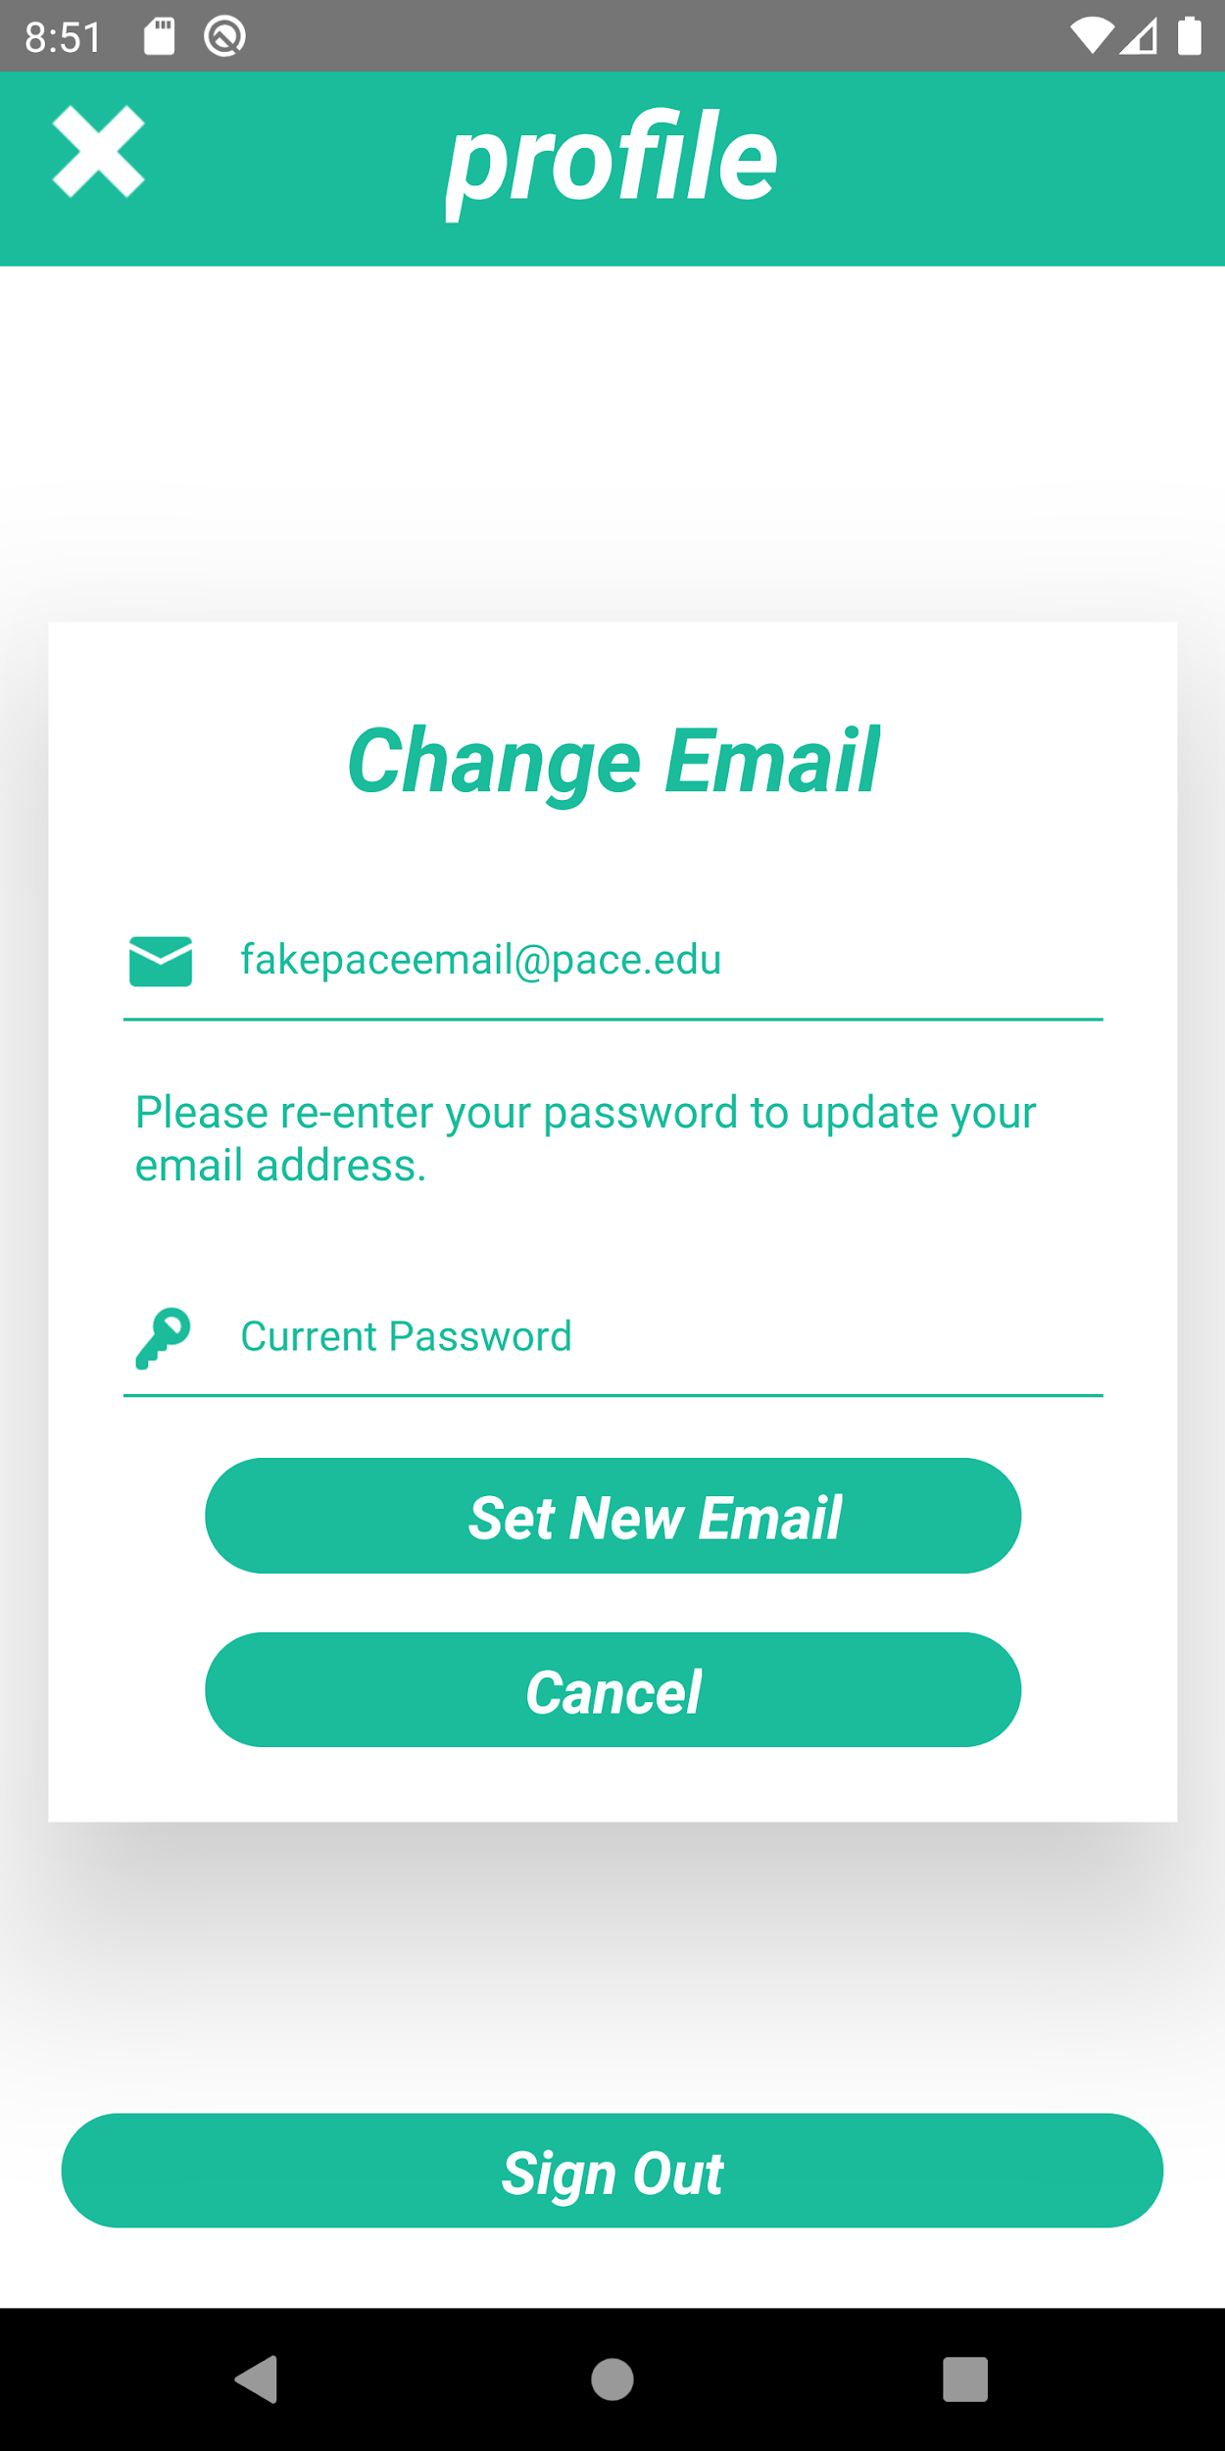
Screenshots

Slide 4
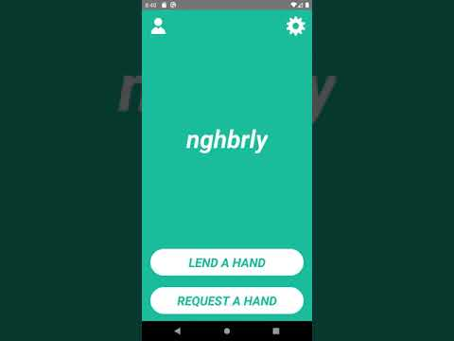
Demo

Slide 5
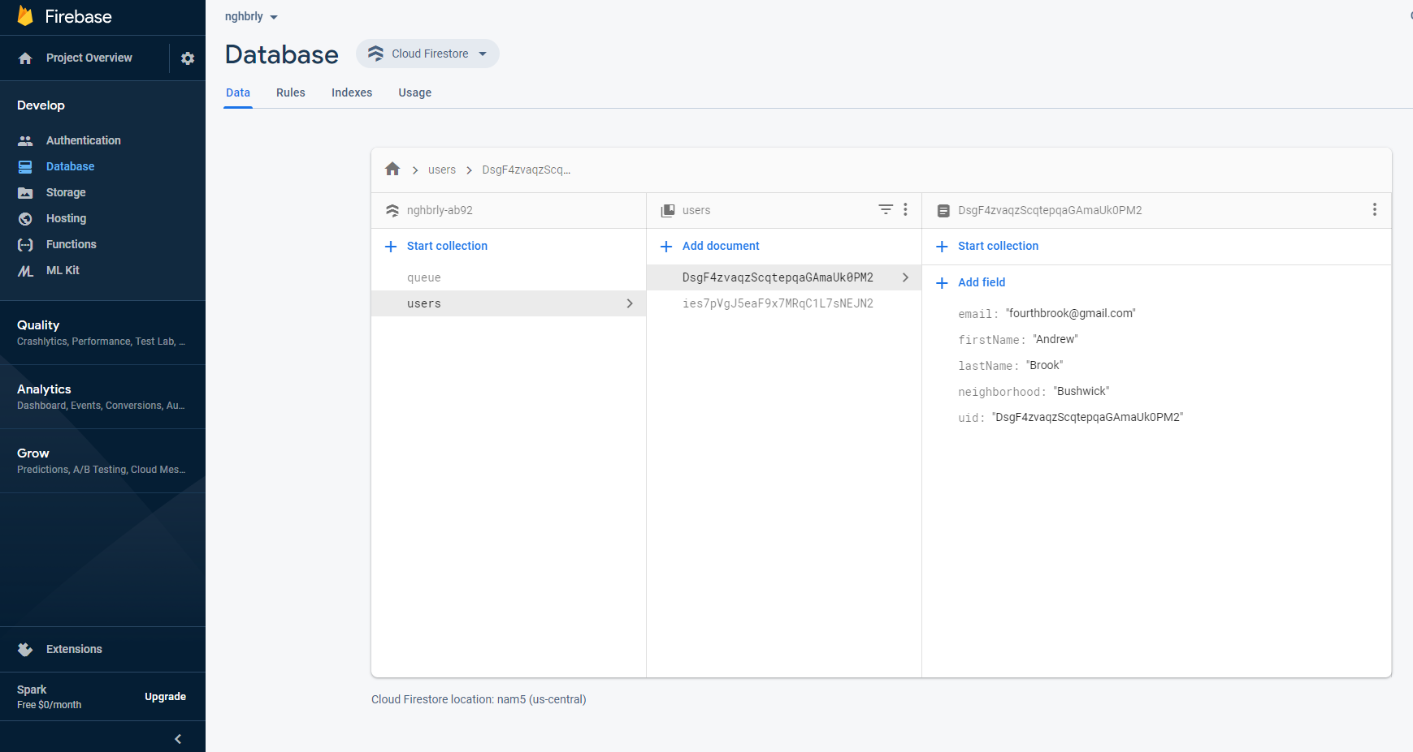
Database Screenshot

Slide 6
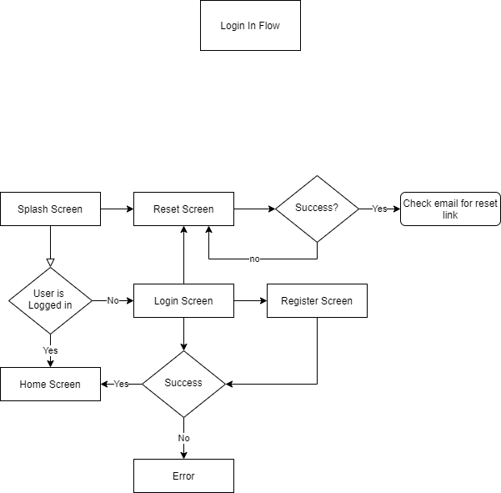
Login UML Diagram

Slide 7
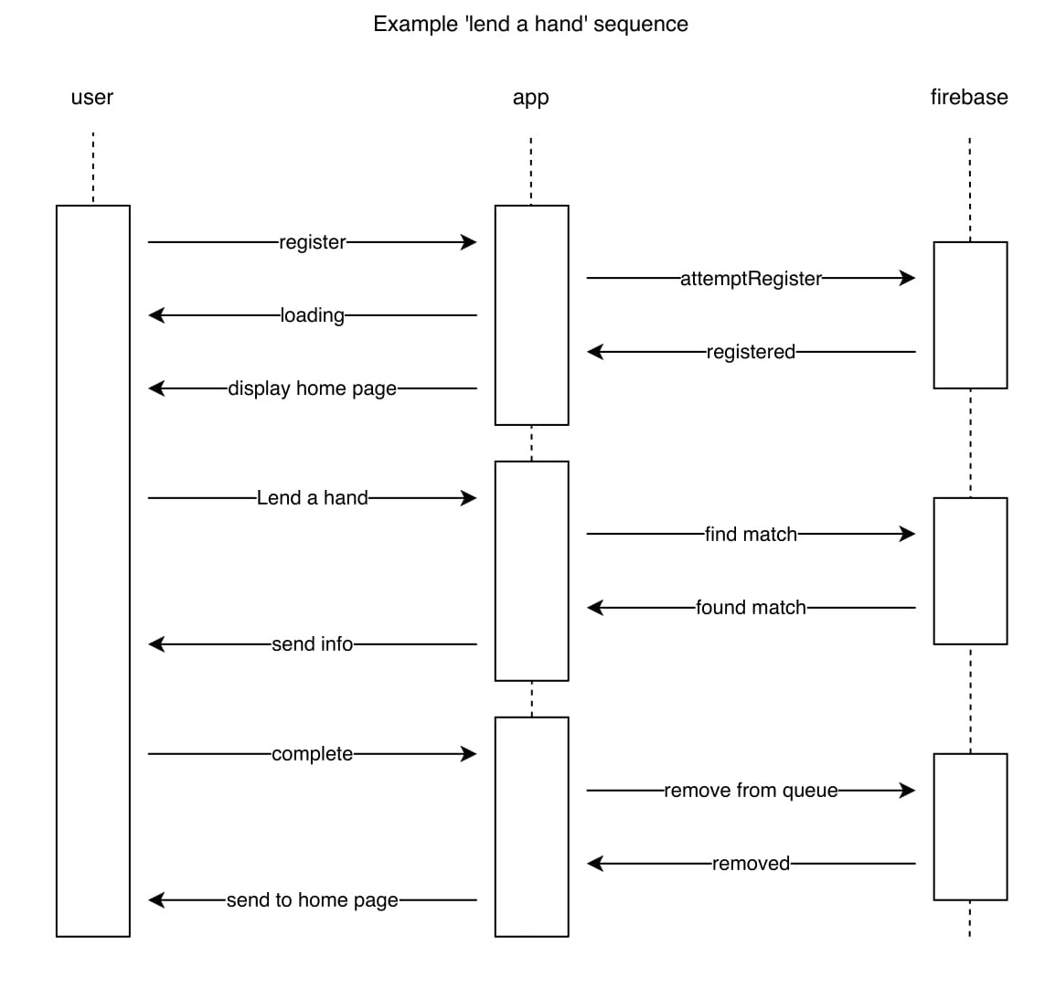
Sequence Diagram

Slide 8
Example Code
import React from 'react';
import {
StyleSheet,
View,
Image,
Text,
Dimensions,
TouchableHighlight,
} from 'react-native';
let deviceHeight = Dimensions.get('window').height;
let deviceWidth = Dimensions.get('window').width;
export default function Home({ navigation }) {
const profileHandler = () => {
navigation.navigate('Profile');
}
const settingsHandler = () => {
navigation.navigate('Settings');
}
return(
<View style={styles.container}>
<View style={styles.topMenu}>
<TouchableHighlight style={styles.profile}
activeOpacity={0.6}
underlayColor="#1ABC9C"
onPress={profileHandler}
>
<Image style={styles.profile}
source={require('../../images/icons/user.png')}
/>
</TouchableHighlight>
});
<TouchableHighlight style={styles.settings}
activeOpacity={0.6}
underlayColor="#1ABC9C"
onPress={settingsHandler}
>
<Image style={styles.settings}
source={require('../../images/icons/settings.png')}
/>
</TouchableHighlight>
</View>
<View style={styles.logo}>
<Text style={styles.logoText}>
nghbrly
</Text>
</View>
<View style={styles.buttons}>
<TouchableHighlight style={styles.button}
onPress={() => {
alert('Feature not yet implamented')
}}
>
<Text style={styles.buttonText}>
LEND A HAND
</Text>
</TouchableHighlight>
<TouchableHighlight style={styles.button}
onPress={() => {
alert('Feature not yet implamented')
}}
>
<Text style={styles.buttonText}>
REQUEST A HAND
</Text>
</TouchableHighlight>
</View>
</View>
)
}

Slide 9
Example Code
const styles = StyleSheet.create({
container: {
flex: 1,
backgroundColor: '#1ABC9C'
},
topMenu: {
flexDirection: 'row',
marginLeft: deviceWidth/30,
marginRight: deviceWidth/30,
height: deviceHeight/10,
justifyContent: 'space-between',
alignItems: 'center'
},
profile: {
height: deviceHeight/15,
width: deviceHeight/15,
},
settings: {
height: deviceHeight/15,
width: deviceHeight/15,
},
logo: {
height: 6*(deviceHeight/10),
justifyContent: 'center',
alignItems: 'center',
},
logoText: {
color: 'white',
fontStyle: 'italic',
fontWeight: '700',
fontSize: 60
},
buttons: {
height: 3*(deviceHeight/10),
paddingLeft: deviceWidth/20,
paddingRight: deviceWidth/20,
paddingTop: deviceWidth/20,
paddingBottom: deviceWidth/15,
justifyContent: 'space-around',
},
button:{
height: deviceHeight/12,
backgroundColor: 'white',
borderRadius: 50,
alignItems: 'center',
justifyContent: 'center'
},
buttonText:{
color: '#1ABC9C',
fontStyle: 'italic',
fontWeight: '700',
fontSize: 30
}

Slide 10
What I learned
Building an app on your own is more time consuming than you might think.
How to use react-native and its many components to build a working app.
How to use Google firebase to register users and store information.
How to install and utilize 3rd party react-native modules.
How to create an app with a specific function in mind.

Slide 11
Link to GitHub
https://github.com/fourthbrook/Spring2020-SoftwareEngineeringProject

